Slide 1

The Gold Mine -An example of the producer/consumer system
BY KRZSZTOF RABKA AND
ADAM SCHAIBLE

Slide 2
Gold Mine Overview
The gold miners work in the gold mine to make gold coins for the bank and deposit them in the bank’s vault as long as the bank’s vault is not full.
The miners are the producers.
The clerks at the bank take requests from the customers for gold coins.
The customers are the consumers of the gold coins.
One customer is served at a time.
The customers requesting a gold coin are given a gold coin by the bank clerk from the vault if its available.

Slide 3
Gold Mine Overview
When a customer is being served the other customers are told to patiently wait while that customer is being served.
Only one miner or bank clerk is allowed to enter the vault at any particular time.
If a miner or bank clerk enters the vault all of the rest of the miners and bank clerks are told not to enter till they are done with using the bank vault.
When a miner or bank clerk has left the vault the other miners and bank clerks are informed that if the vault is not full another miner may enter the vault.
After a customer has gotten their gold coin the clerks are free to process another customers gold coin request.

Slide 4
Gold Mine Overview
If the banks vault is empty the requesting customer must wait for the miners to replenish the vault with gold coins before the bank clerk can get them a gold coin from the bank vault.
The every customer, bank clerk and miner are each their own thread.
The serverSocket.accept() method allows the customer to initiate a conversation with a bank clerk.
To ensure that only one bank clerk or one miner is allowed in the bank vault at a particular time the methods takeGold() and depositGold() are synchronized.

Slide 5
Gold Mine Overview
By synchronizing takeGold() and depositGold() this ensures that gold coins cannot be taken out of the vault at the same time that they are deposited.
Within 3 to 5 seconds of a customer getting a gold coin they want another gold coin.
It takes the miners 3 to 5 seconds to produce another gold coin.

Slide 6
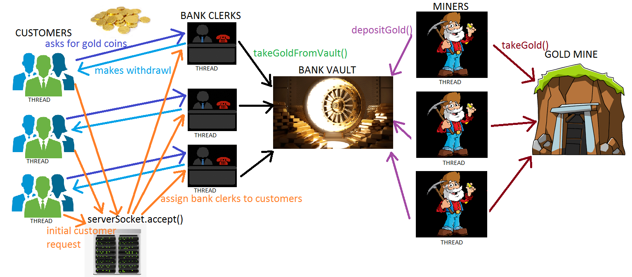
Gold Mine Overview

Slide 7
The running of the gold mine
The server is launched. The launching of the server creates miners for the gold mine, bank clerks and a bank with a vault.
The clients are then created and start requesting their gold coins and consume them as they are available.
Eventually the mine runs dry of gold and the miners cannot make any more gold coins.
The vault becomes empty as customers consume the last of the gold coins.
After this the bank closes down and tells the customs to go home.
All of the customer, bank clerk and miner threads are now closed.
OUR GOLDMINE IS NOW OUT OF BUSINESS

